Slide 1
Plotting a relationship
Plotting coordinates

Slide 2
how to use Oak lessons

Slide 3
I can use a graphical representation to show all of the points (within a range) that satisfy a relationship.

Slide 4
Substitute means to put in place of another. In Algebra, substitution can be used to replace variables with values.
An integer is any positive or negative whole number or zero. E.g. -2, 0, 153 are all examples of integers.

Slide 5

Plotting a relationship
Plotting lines from coordinates
Identifying whether points are on a line

Slide 6
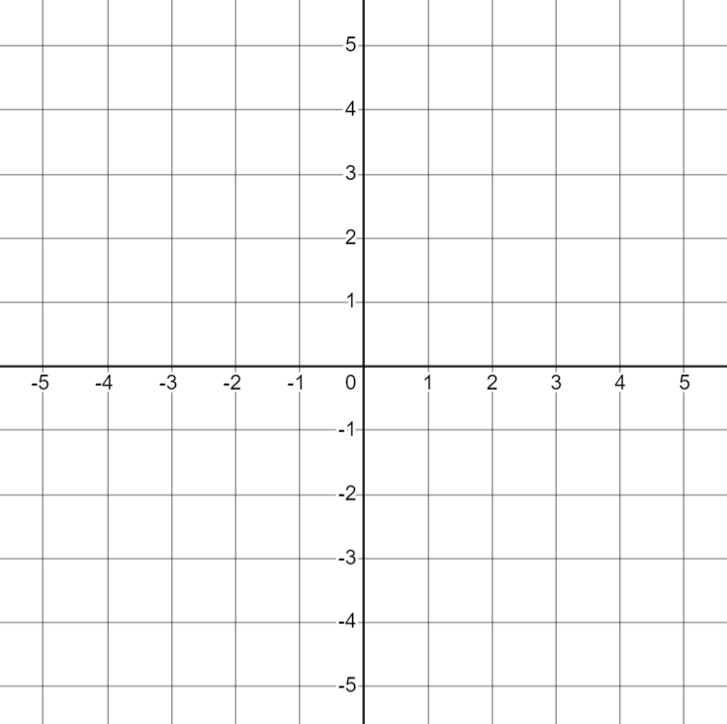
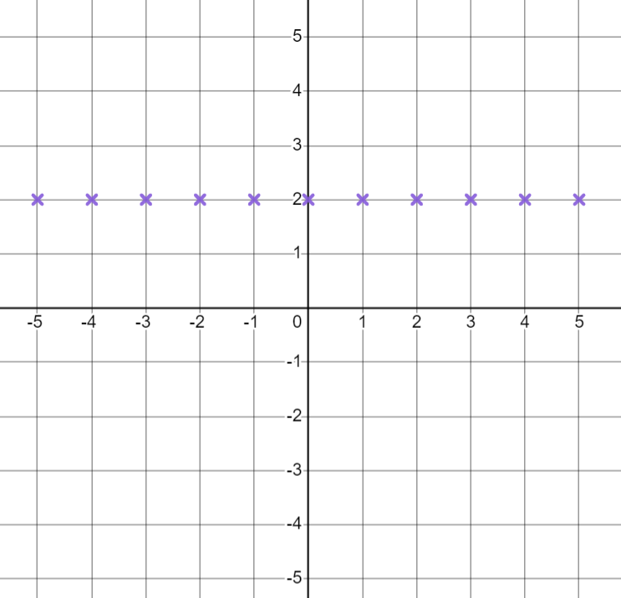
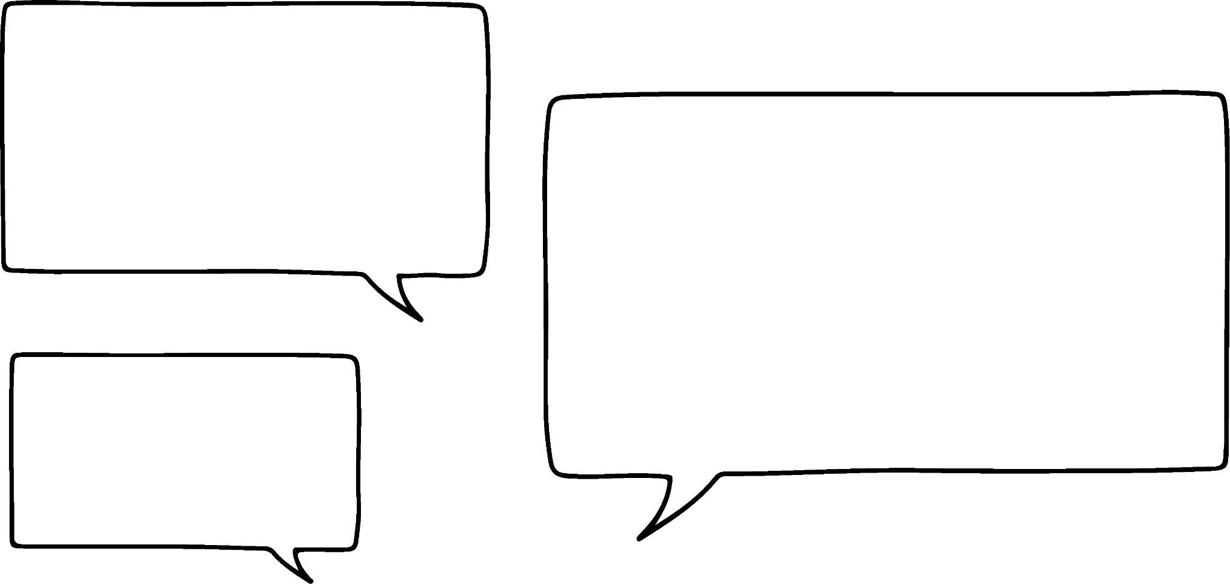

Plotting lines from coordinates
Aisha draws the axes below:
She then plots the points
(-5,2) (-4,2) (-3,2) (-2,2) (-1,2) (0,2) (1,2) (2,2) (3,2) (4,2) (5,2)
I have plotted all the coordinates where the y coordinate is 2
Aisha
Do you agree with Aisha’s statement?

Slide 7

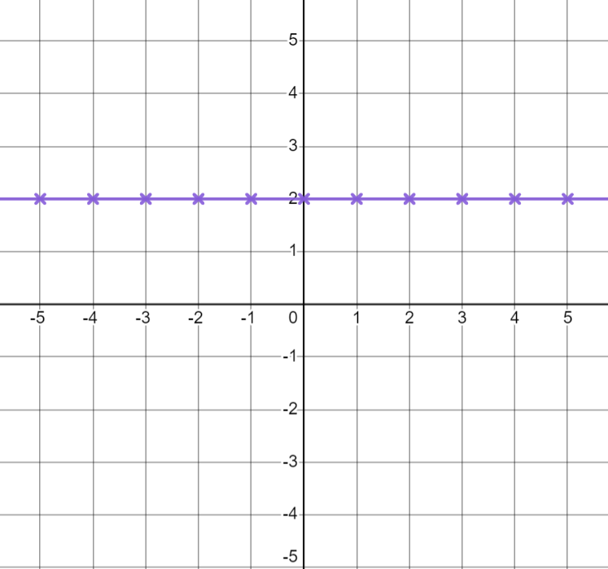
Plotting lines from coordinates
Aisha has plotted all the integer coordinates on her axis where
Does the coordinate
(-1.5,
2)
also fit this rule?
Yes
Can you think of any others?
How could Aisha show all the points that fit this rule?
Drawing the line through the points means all the non-integer coordinates are also represented.

Slide 8

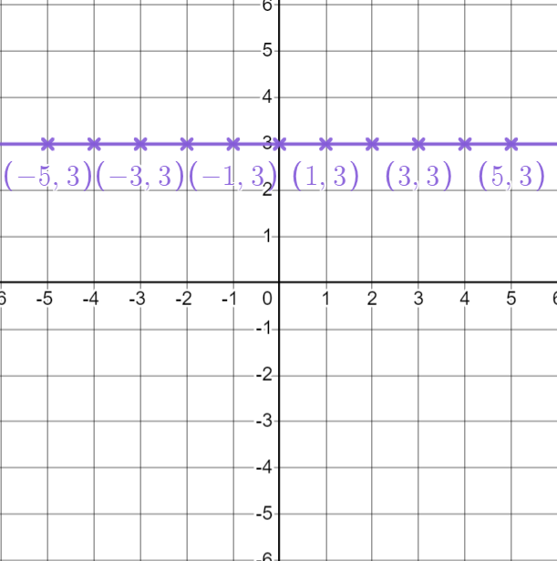
Plotting lines from coordinates
We call this line
What do you think we call this line?

Slide 9
Plotting lines from coordinates
Lines represent all coordinates that follow a rule.
By drawing a line, we have represented an infinite number of points that follow a rule (within the range -5 to 5 in this case).
Graphing software can represent an infinite number of points without the restriction of a range.

Slide 10

Plotting lines from coordinates
We can draw lines that represent a rule by choosing some coordinates that fit a rule.
Aisha wants to draw the line that represents all coordinates that fit the rule
How many coordinates does she need to plot?

Slide 11
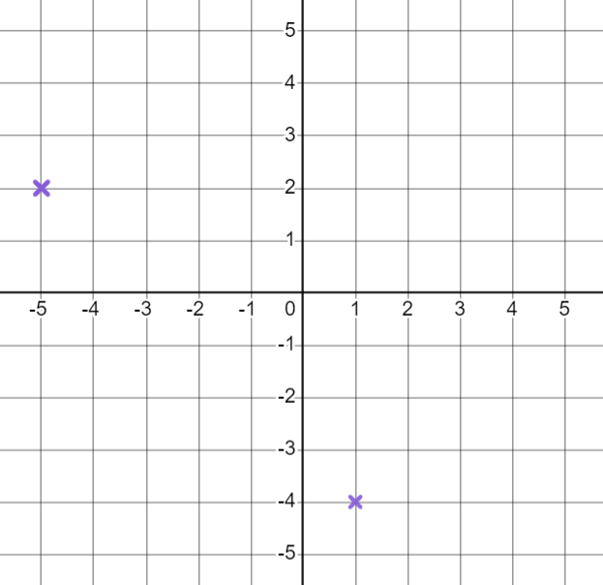
Plotting lines from coordinates
How many different ways can you join these two coordinates with a ruler?
One
The minimum number of coordinates needed to draw any line is 2

Slide 12



Plotting lines from coordinates
Aisha wants to draw the line that represents all coordinates that fit the
rule
on the axis below.
Her classmates suggest some points to plot.
Plot (3,4)
Andeep
Plot (4,10)
Laura
Plot (4,2.1)
Can you spot any errors or difficulties with each suggestion?
Sofia

Slide 13
Plotting lines from coordinates
Aisha wants to draw the line that represents all coordinates that fit the
rule
on the axis below.
Her classmates suggest some points to plot.
Plot (3,4)
The coordinate needs to be 4. Andeep has written a coordinate with a coordinate of 4
Andeep
Aisha’s axes only go up to 5 in either direction so even though this follows the rule, it will not fit on her graph.
Plot (4,10)
Laura
Plot (4,2.1)
This coordinate does fit the rule however it might be difficult to plot accurately. An integer coordinate may be better in this case.
Sofia

Slide 14
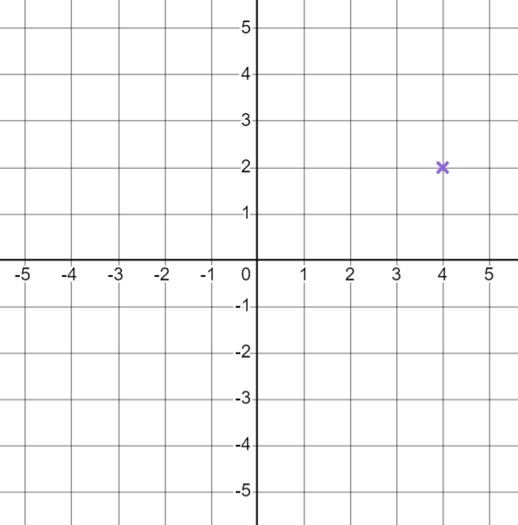
Plotting lines from coordinates
Aisha chooses the coordinate (4,2)
Suggest another sensible coordinate to plot for
E.g. (4,-5) (4,-4) (4,-3) (4,-2) (4,-1) (4,0) (4,4) (4,5)
(4,1) and (4,3) are okay but are quite close to (4,2)
This can make it trickier to line up with a ruler.
Choosing coordinates further away will make it easier to draw an accurate line.

Slide 15
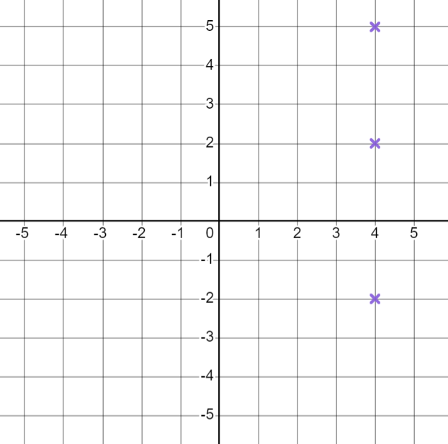
Plotting lines from coordinates
Two coordinates is the minimum needed but it is often helpful to plot at least 3 to get an idea of the pattern.
Aisha chooses the coordinates (4,5) and (4,-2)
To show all the points she joins the coordinates with the ruler.
Has she shown all coordinates that fit this rule?

Slide 16
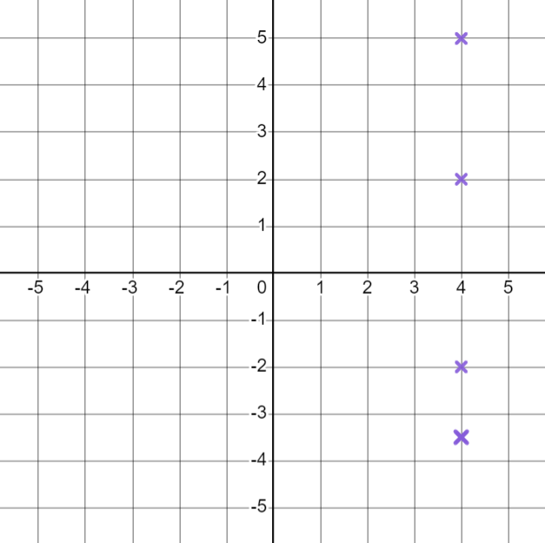
Plotting lines from coordinates
Does
the
coordinate
(4, -3.5)
fit the rule
?
Yes
Does it lie on the line Aisha has drawn?
No
Aisha needs to draw a line across the whole coordinate grid to show all the coordinates that fit the rule

Slide 17


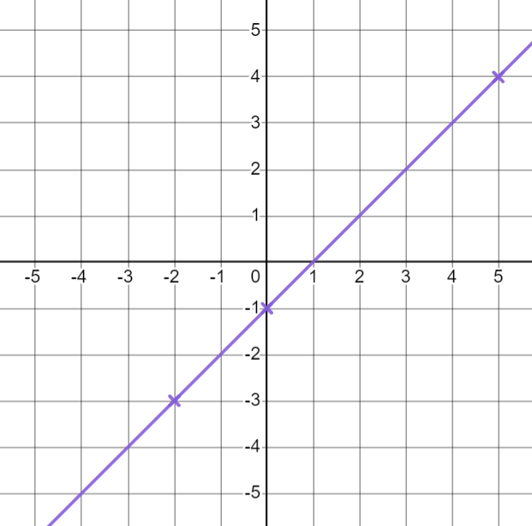
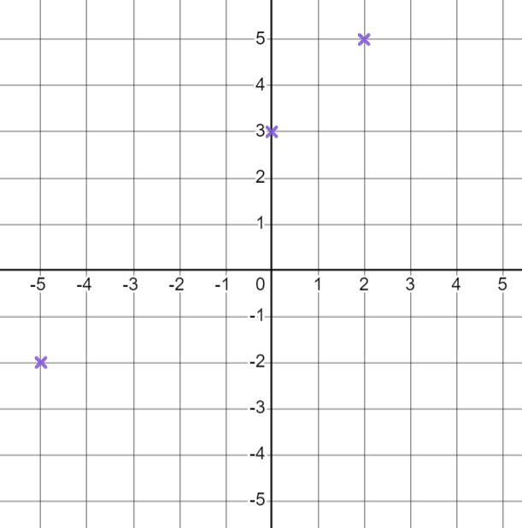
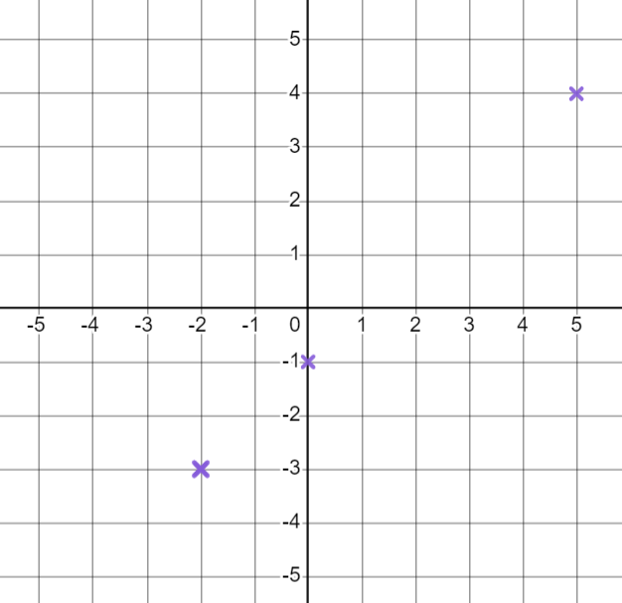
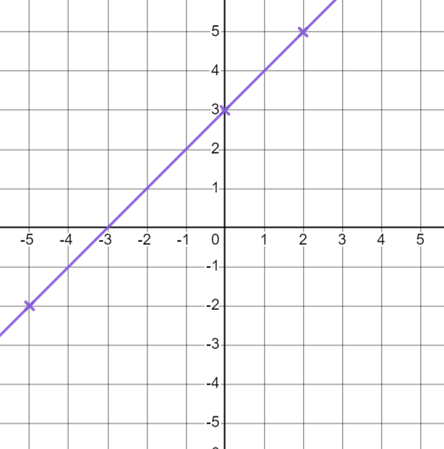
Plotting lines from coordinates
Plot the line for the rule
Plot a line for the rule
Pick 2 or 3 coordinates that follow the rule
Pick 2 or 3 coordinates that follow the rule
E.g. (0,3) (2,5) (-5,-2)
E.g. (0,-1) (5,4) (-2,-3)
Plot those coordinates
Plot them
Draw a straight line with a ruler
Draw a straight line

Slide 18

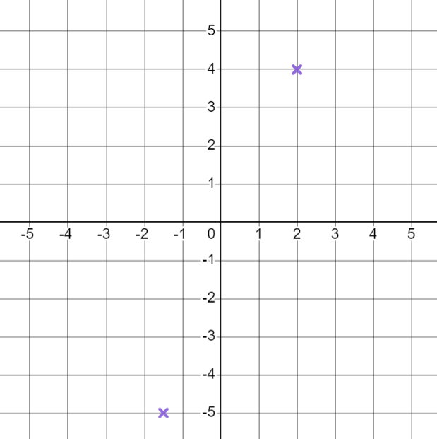
Plotting lines from coordinates
Andeep has tried to plot the line
Identify any mistakes.
I have chosen the coordinates (-2.5,-5) and (2,4) plotted them and drawn the line for
Andeep

Slide 19
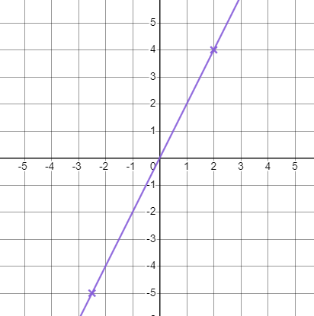
Plotting lines from coordinates
Andeep has tried to plot the line
Identify any mistakes.
I have chosen the coordinates (-2.5,-5) and (2,4) plotted them and drawn the line for
He has plotted (-1.5,-5) not (-2.5,-5)
His line should go across the entire axes to represent all points.
Andeep

Slide 20



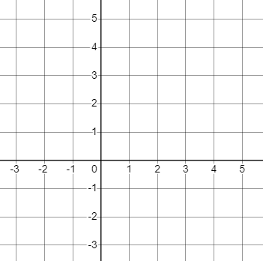
Plotting lines from coordinates
For each rule, fill in the coordinates. Use them to draw the line for that rule.
a)
b)
c)
(1, ) (-3, ) ( , )
(0, ) ( ,-1) ( , )
( ,-3) ( ,1) ( , )

Slide 21



Plotting lines from coordinates
For each rule, fill in the coordinates. Use them to draw the line for that rule.
d)
e)
f)
(-2, ) ( ,5) ( , )
(-3, ) ( ,2) ( , )
( , ) ( , ) ( , )

Slide 22
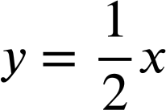


Plotting lines from coordinates
For each rule, fill in the coordinates. Use them to draw the line for that rule.
g)
h)
i)
(2, ) ( ,0) ( , )
(0, ) ( , ) ( , )
(0, ) ( ,-1) ( , )

Slide 23
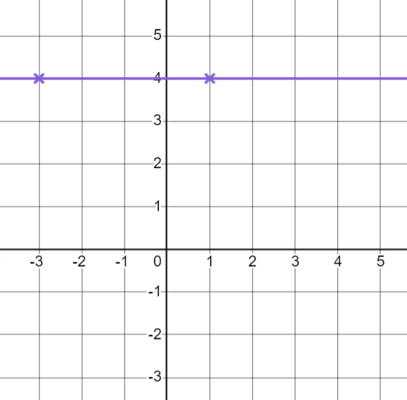
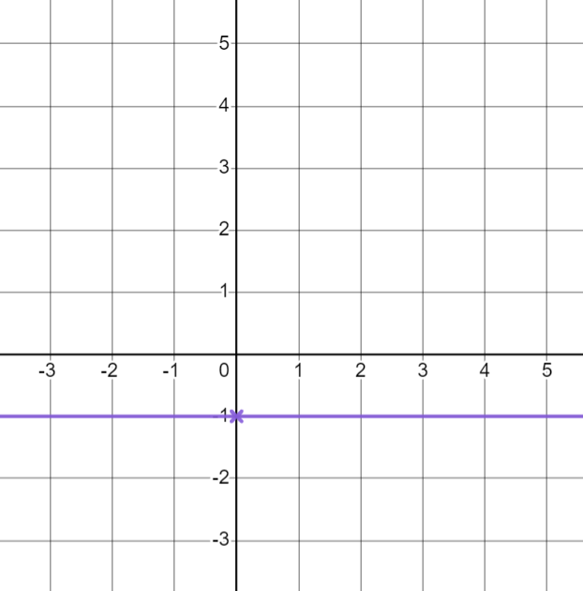
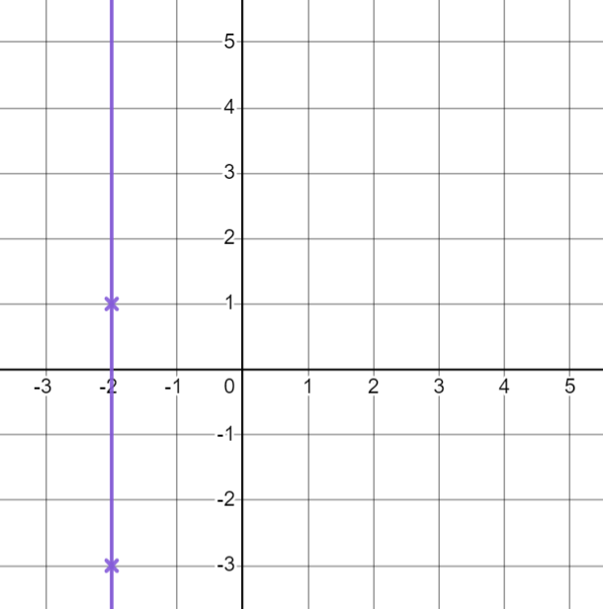
Plotting lines from coordinates
For each rule, fill in the coordinates. Use them to draw the line for that rule.
a)
E.g.
(3,4)
b)
E.g.
(4,-1)
c)
E.g.
(-2,4)
(1, 4 ) (-3, 4 )
(0,-1) (?,-1)
(-2 ,-3) (-2 ,1)

Slide 24
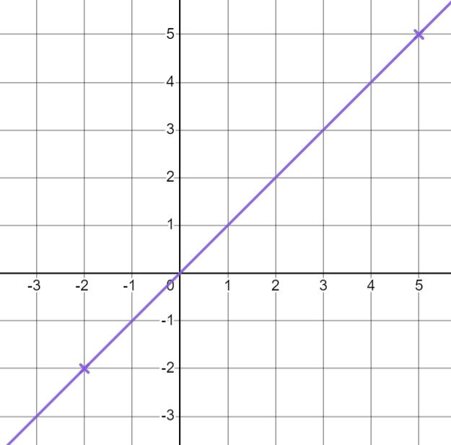
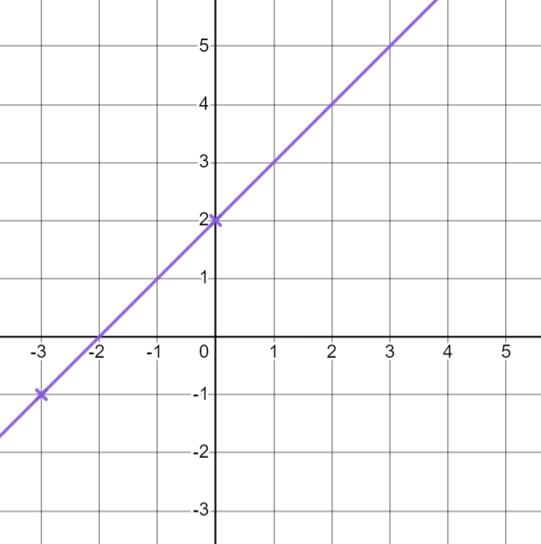
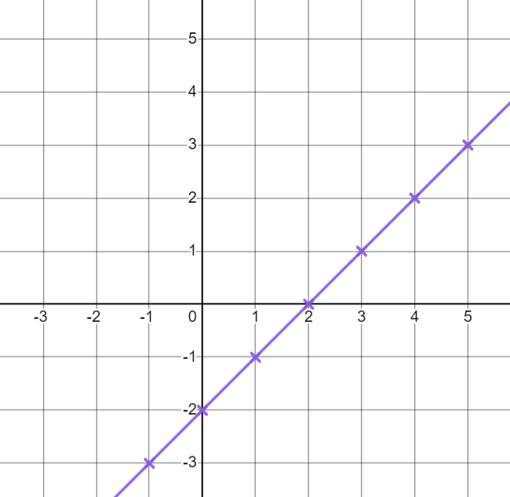
Plotting lines from coordinates
For each rule, fill in the coordinates. Use them to draw the line for that rule.
d)
e)
f)
E.g.
(1,1)
E.g.
(3,5)
E.g.(-1,-3) (0,-2) (1,-1) (2,0) (3,1) (4,2) (5,3)
(-2,-2 ) ( 5 ,5)
(-3, -1 ) ( 0 ,2)

Slide 25
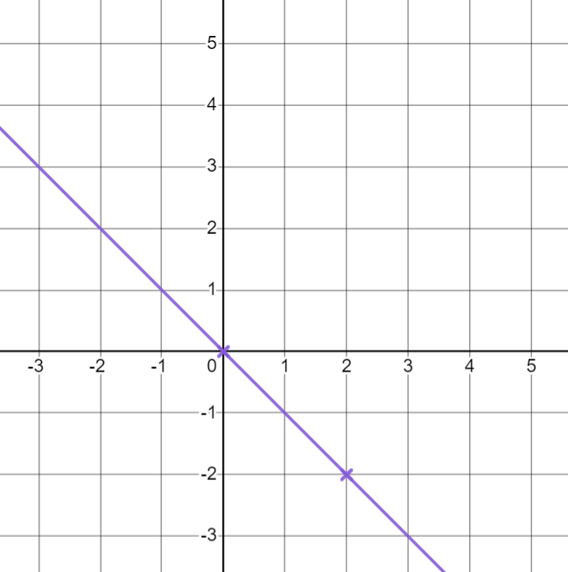
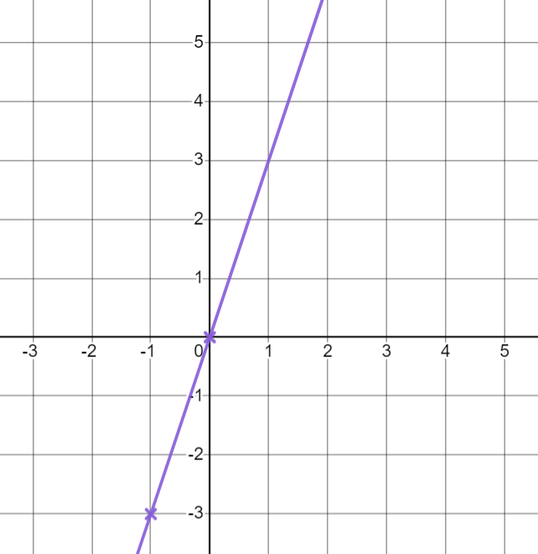
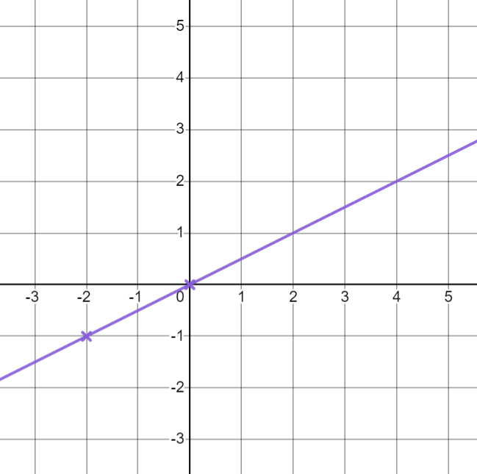
Plotting lines from coordinates
For each rule, fill in the coordinates. Use them to draw the line for that rule.
g)
h)
i)
E.g.
(-3,3)
E.g.
(-1,-3) (1,3)
E.g.
(4,2)
(2,-2 ) ( 0 ,0)
(0, 0 )
(0, 0 ) (-2 ,-1)

Slide 26
Plotting a relationship
Plotting lines from coordinates
Identifying whether points are on a line

Slide 27
Identifying whether points are on a line
We can substitute any x value into our rule to work out the corresponding y value.
How could we work out the missing value in this coordinate
for the rule y = 4x – 5 ?
(3, )
7
4 × (3) - 5
12 - 5
7

Slide 28
Identifying whether points are on a line
We can substitute any x value into our rule to work out the corresponding y value.
How could we work out the missing value in this coordinate for
the rule y = 4x – 5 ?
(5, )
15
4 × (3) - 5
4 × (5) - 5
12 - 5
20 - 5
7
15

Slide 29
Identifying whether points are on a line
We can substitute any x value into our rule to work out the corresponding y value.
How could we work out the missing value in this coordinate for
the rule y = 4x – 5 ?
-21
(-4, )
4 × (3) - 5
4 × (5) - 5
4 × (-4) - 5
12 - 5
20 - 5
-16 - 5
7
15
-21

Slide 30
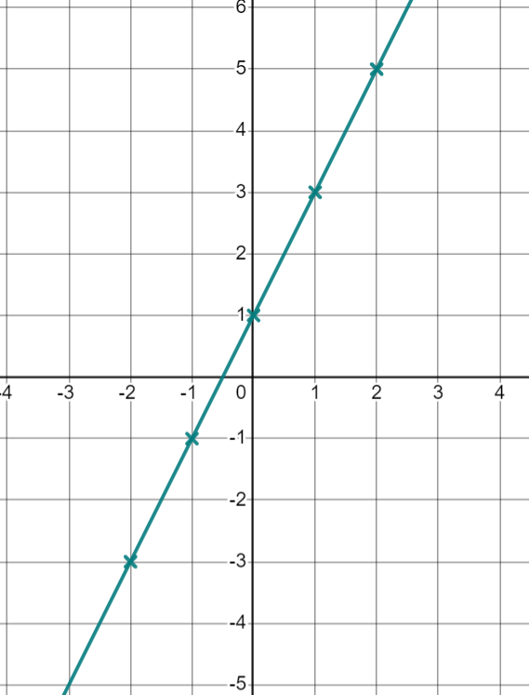


Identifying whether points are on a line
Any coordinate on a line will satisfy the rule for that line
Here is the line of
For any coordinate on this line the y
value will equal
(1,3)
(0,1)
3 = 2 × (1) + 1
1 = 2 × (0) + 1
(-1,-1)
-1 = 2 × (-1) + 1
(-2,-3)
-3 = 2 × (-2) + 1

Slide 31
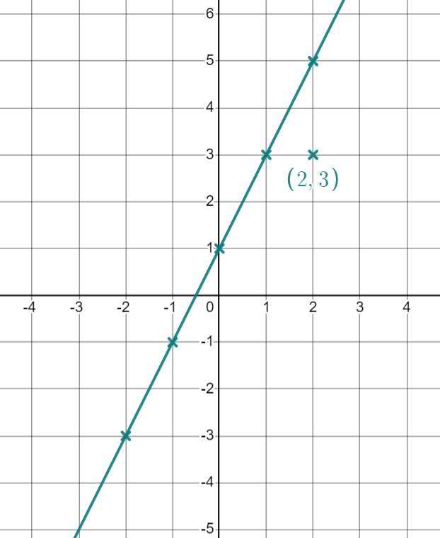
Identifying whether points are on a line
If a coordinate is not on the line it will not satisfy the rule
(2,3) is not on the line
2 × (2) + 1 does not equal 3

Slide 32
Identifying whether points are on a line
We can check if a coordinate is on a line by checking if the x
and y values satisfy the rule.
Substitute the x coordinate into the equation and see if it gives you the y coordinate.
Will the
coordinate
(6,13) be on the line?
2 × (6) + 1 = 13
so yes
Will the
coordinate
(-4,-9) be on the line?
2 × (-4) + 1 = -7
so no

Slide 33


Identifying whether points are on a line
Which of these coordinates are on
the line
?
5 × (2) + 10 = 20
5 × (-10) + 10 = -40
5 × (7) + 10 = 45
5 × (9) + 10 = 55 not 65
(2, 20)
(-10,-40)
(7, 45)
(9, 65)

Slide 34






Identifying whether points are on a line
For each equation, does the coordinate lie on the given line? Give a reason for your answer.
(4,18)
(6,-12)
(0,0)
(25,22.5)
(11,37)
(10, 50)

Slide 35
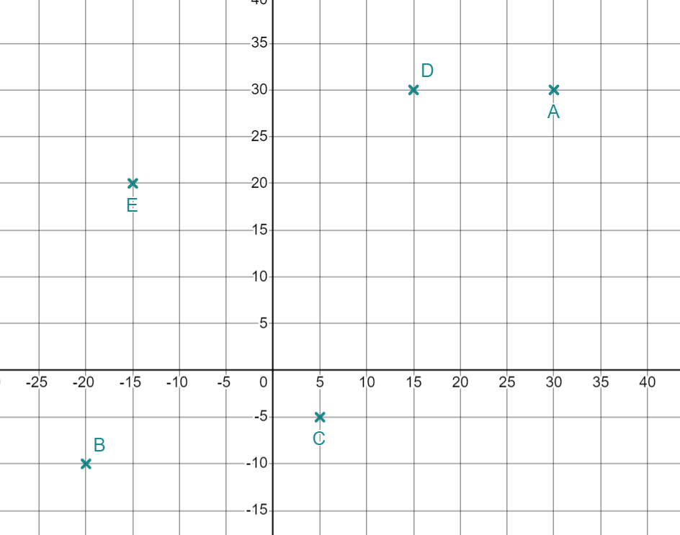



Identifying whether points are on a line
2) Alex has started to plot some lines.
He has plotted one point from each line but cannot remember which point goes with which line.
Match the points with the equation for the line Alex has tried to plot.
a)
b)
c)
d)
e)

Slide 36
Identifying whether points are on a line
For each equation, does the coordinate lie on the given line? Give a reason for your answer.
(4,18)
(6,-12)
(0,0)
(25,22.5)
(11,37)
(10, 50)
No 4 × 5 ≠ 18
Yes 6 × -2 = -12
Yes 0 × 3.5 = 0
No 25 - 5.5 ≠ 22.5
Yes 11 × 3 + 4 = 37
No 10 × 5 - 8 ≠ 50

Slide 37
Identifying whether points are on a line
2) Alex has started to plot some lines.
He has plotted one point from each line but cannot remember which point goes with which line.
Match the points with the equation for the line Alex has tried to plot.
a)
b)
c)
d)
e)
E (-15,20)
A (30,30)
D (15,30)
C (5,-5)
B (-20,-10)

Slide 38
Plotting a relationship
A line can be drawn using coordinates found following a rule.
We can identify whether points are on a line by substituting the x and y coordinate values into the equation for the line.

Slide 39

© Oak National Academy 2023.
Produced in partnership with Mathematics in Education and Industry.
Licensed on the Open Government Licence v3.0, except where otherwise stated. See Oak terms and conditions.

